Slide 1
Tableau pre-training assessment results
Open dates: 4/19 to 5/14/2018

Slide 4
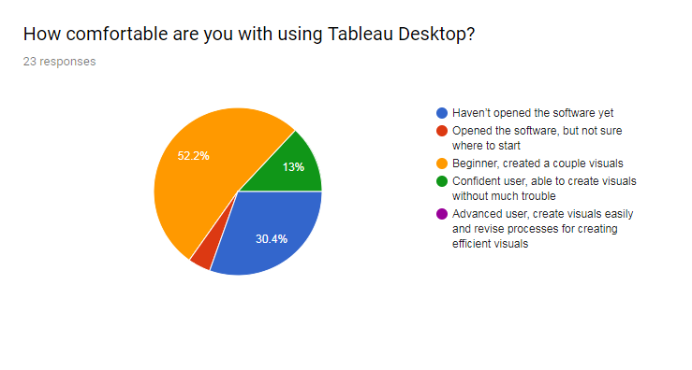

Slide 6
What is one thing you hope to learn from this training?
Tableau visualization
Advanced visualizations
Walking through the entire process of importing a dataset, extracting a dataset, creating some simple visuals, and then exporting the visuals. I feel relatively confident in my ability to build visuals in Tableau, but struggle with the importing process. I'd also like to learn some fun tips for creating visuals. Basically how to make things pretty. :)
Would like to get a good general understanding of how to use Tableau for basic visualization needs.
TO BE INTRODUCED TO TABLEAU APPLICATION
how to manage MER structured data for visuals in tableau
being familiar with Tableau in generating visuals from our MER data
How to create dynamic visuals and especially GIS functions in Tableau
Tableau functionality
Improve my skills in using Tableau and gain practice working with MER data in Tableau.
How to best use Tableau at ICPI
How to make visualizations and dashboards
Being able to use Tableau for data visualization
The format of data that's most compatible w/ tableau (for ex., how we should restructure our MER structured datasets in R so that they're more compatible w/ R)
Increase knowledge in creating dashboards
How to import and work with datasets in tableau
SUMMARY
Restructure data for Tableau
Import and work w/MER datasets
Basic visualizations
Advanced Visualizations
GIS

